Slide 1
ECE 313: PROBABILITY WITH ENGINEERING APPLICATIONS
Fall 2023
Prof. Eric Chitambar
Lecture 11

Slide 2


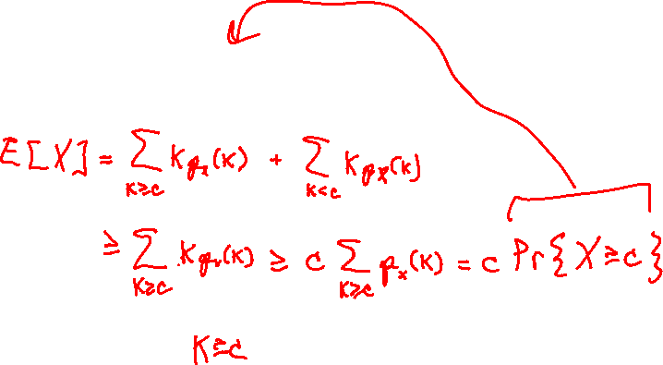
Markov’s Inequality

Slide 3








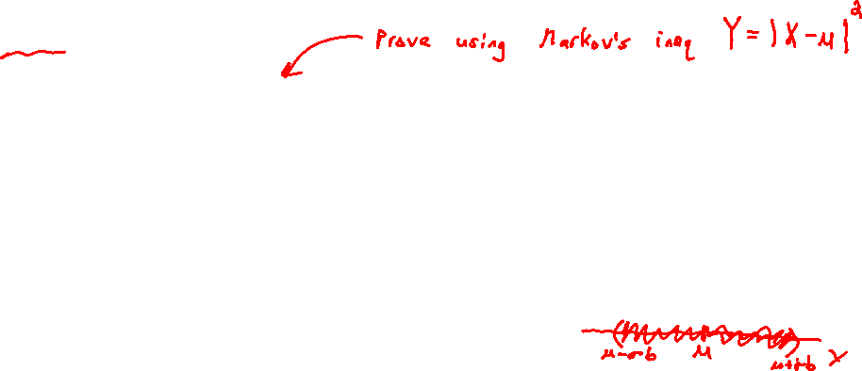
Chebyshev’s Inequality

Slide 4

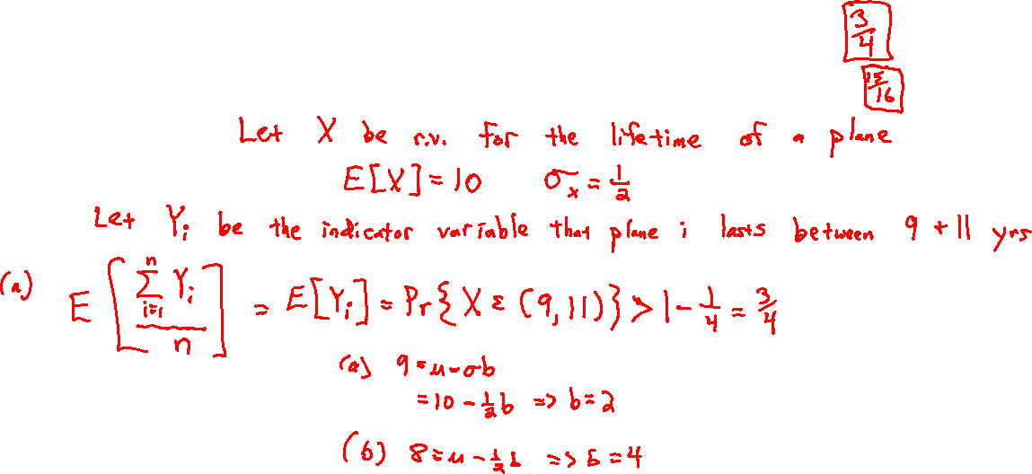
Chebyshev’s Inequality

Slide 5
Confidence Intervals

Slide 6







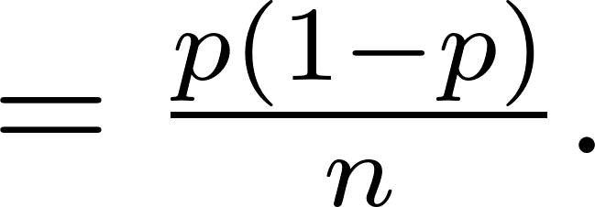

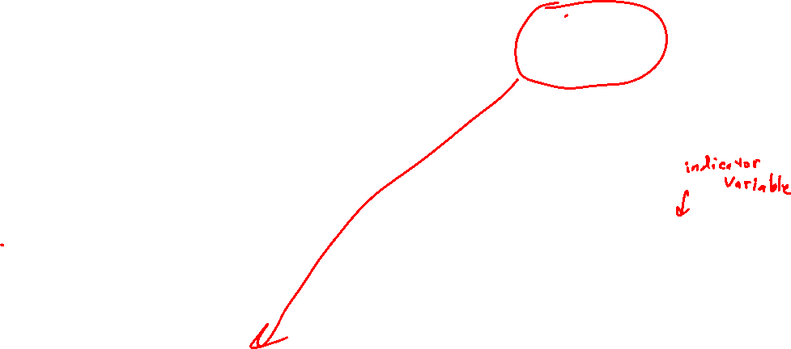
Confidence Intervals

Slide 7


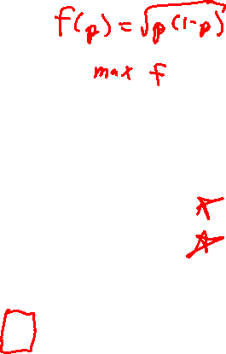
Confidence Intervals

Slide 8


Confidence Intervals

